Slide 1

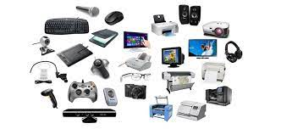



What is today’s topic?

Slide 2

Computing Devices
Lesson 2
ESL/EFL Teacher: Ms. Zulfiya

Slide 3
AGENDA
Learn subject specific vocabulary
Use structures for expressing function
Read for specific information
Listen for specific information

Slide 4
Let’s talk about these questions!
1. How have computer monitors improved over time?
2. What is the purpose of a frame buffer?

Slide 5
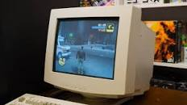






CRT monitor

Slide 6
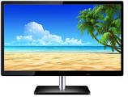
WHOA!
This can be the part of the presentation where you introduce yourself, write your email…
LCD
Liquid crystal tube

Slide 7

WHOA!
This can be the part of the presentation where you introduce yourself, write your email…
Pixel

Slide 8
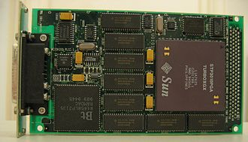
WHOA!
This can be the part of the presentation where you introduce yourself, write your email…
Frame buffer

Slide 9
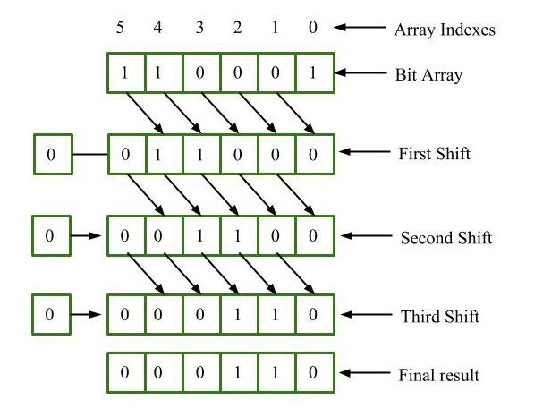
WHOA!
This can be the part of the presentation where you introduce yourself, write your email…
bitmap

Slide 10
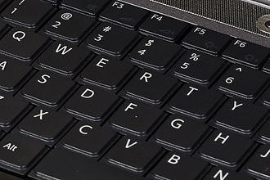
WHOA!
This can be the part of the presentation where you introduce yourself, write your email…
QWERTY

Slide 11

WHOA!
This can be the part of the presentation where you introduce yourself, write your email…
GUI
Graphic User Interface

Slide 12
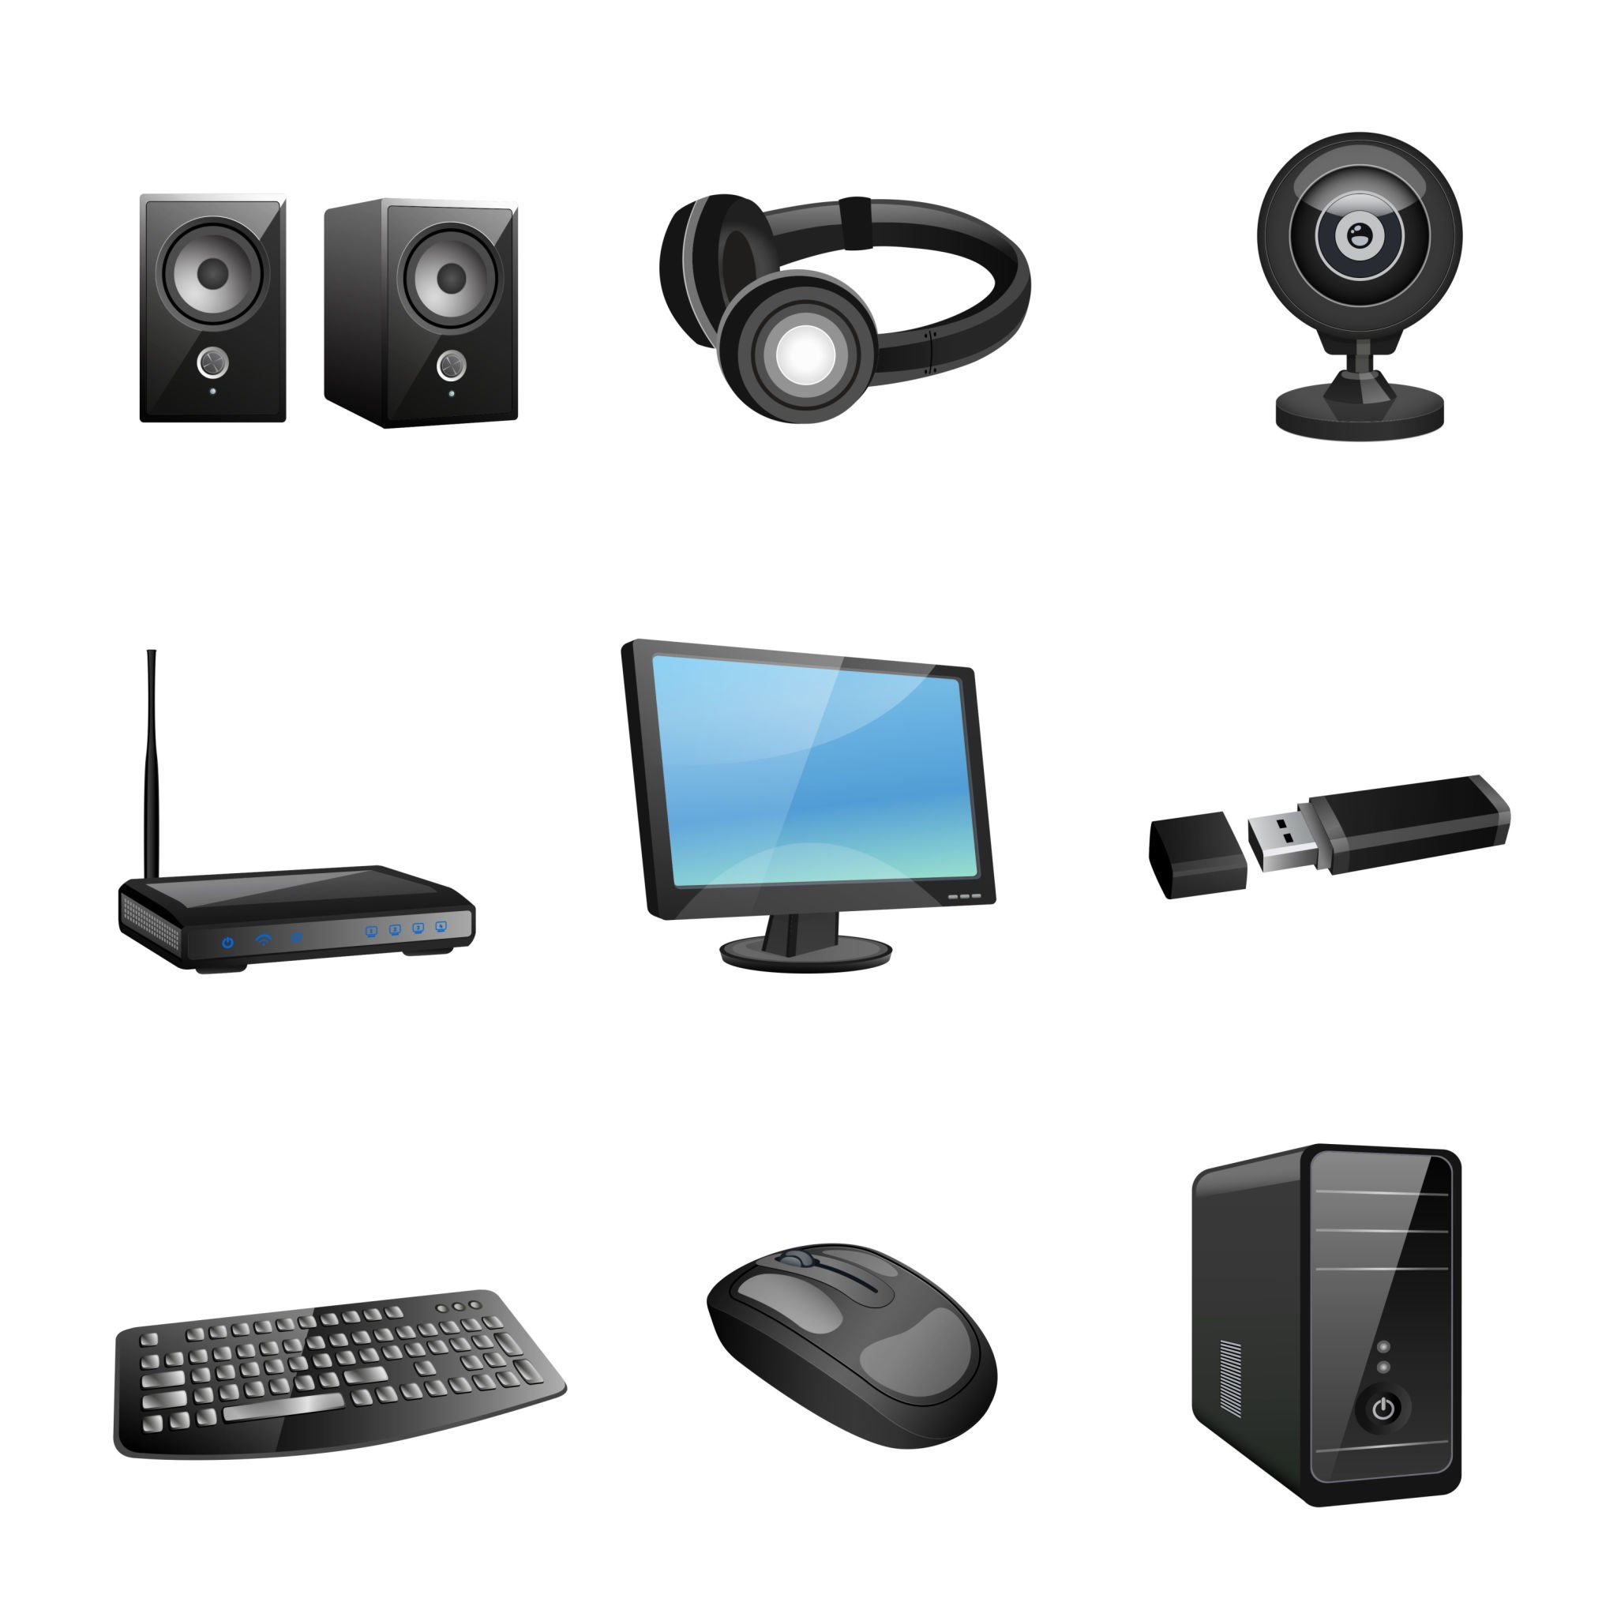
WHOA!
This can be the part of the presentation where you introduce yourself, write your email…
peripheral

Slide 13
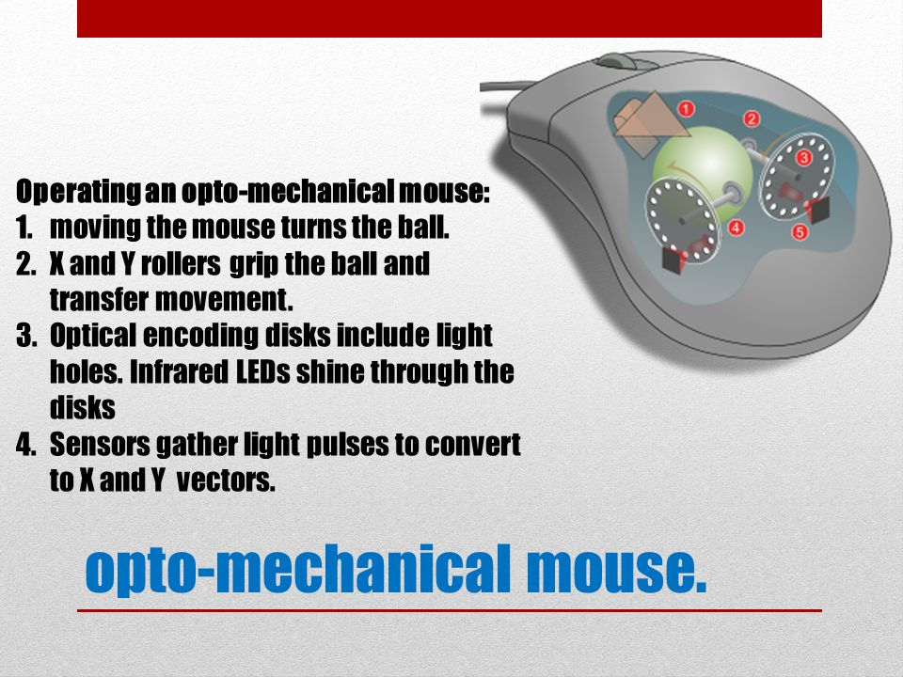
WHOA!
This can be the part of the presentation where you introduce yourself, write your email…

Slide 14


Complete the puzzle using the clues.

Slide 15
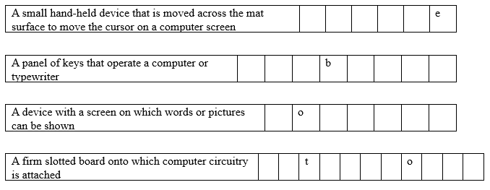
Answers: 1. Mouse 2. Keyboard 3. Monitor 4. Motherboard

Slide 16
Match the words or phrases with the definitions
1. GUI | A. An icon on a computer’s display controlled by a mouse
2. Button | B. An input device that uses a ball to track its movement
3. Pointer | C. The part of a device that a user presses to perform a function
4. Keyboard | D. An input device with many keys for inputting data
5. scroll wheel | E. An input device that uses an LED to track its movement
6. optical mouse | F. A visual display that computer users can interact with
7.electromechanical mouse | G. A device on a mouse that lets users move up and down smoothly on a screen
8. Peripheral | H. Any device that is connected but not built into a computer

Slide 17
Let’s check your answers
01 - F
02- C
03 - A
04 - D
05 – G 06 - E
07 – B 8 - H

Slide 18
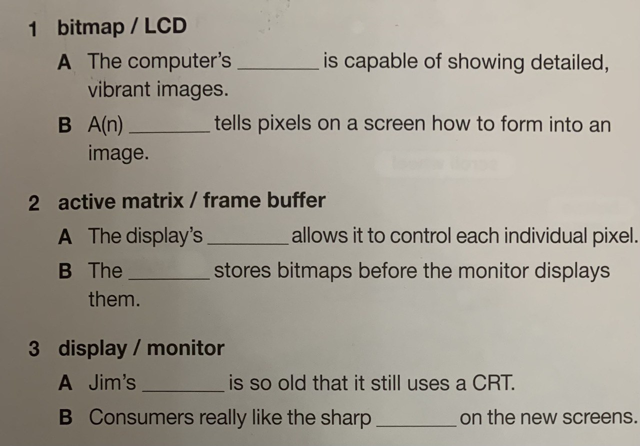
THE SLIDE TITLE GOES HERE!
LCD
bitmap
Do you know what helps you make your point clear?
Lists like this one:
They’re simple
You can organize your ideas clearly
You’ll never forget to buy milk!
And the most important thing: the audience won’t miss the point of your presentation
active matrix
frame buffer
monitor
display

Slide 19
Read the text and answer the question

Slide 20
What are an electromechanical mouse ‘s main features?
Read the product description again and answer the question.

Slide 21
Vanrey 5650
Desktop Computer
Included Peripherals
Every desktop model comes with a Vanrey keyboard. This QWERTY keyboard features new quiet–key technology. It also comes with wrist support to reduce muscle strain. Each unit also comes with the Vanrey EM750 electromechanical mouse. Scroll smoothly with a durable scroll wheel. Then easily click your selections with the two large buttons. This standard mouse is perfect for light, everyday use.
Recommended Peripherals
The Vanrey Omega optical mouse tracks movements with LEDs. This mouse is recommended for architects, engineers, and other design professionals. It guides pointers across GUIs with precise, smooth movements. This accessory is sold separately.

Slide 22
Mark the statement as TRUE or FALSE
1. | Users can choose which keyboard the computer comes with.
2. | An electromechanical mouse is included with the computer.
3. | The optical mouse is recommended for design professionals.
F
T
T

Slide 23

Listen to a conversation between a computer store employee and a customer. Mark the following statements as True or False.
1 The fan will not turn on. | True False
2 The woman suspects the power supply is broken. | True False
3 The woman must open the case. | True False

Slide 24
Listen again and complete the gaps
Employee: Good afternoon. How 1) ______ ________ help you?
Customer: Hello. I have a problem with my computer. The fan is 2) ____ ________ ________________.
Employee: I see. Is it new?
Customer: No, I've had it 3) _________ _________ a year.
Employee: Maybe the heat sink is broken. 4) _____ _____ make the fan work too hard.
Customer: 5) ______ ___________ . Can you replace it?
Employee: I'll have to open the case 6) ________ ______. Can you leave it overnight?
Customer: Sure. I'll be back tomorrow afternoon. Thanks.

Slide 25
Check your answers
Employee: Good afternoon. How 1) can I help you?
Customer: Hello. I have a problem with my computer. The fan is 2) way too loud.
Employee: I see. Is it new?
Customer: No, I've had it 3) for about a year.
Employee: Maybe the heat sink is broken. 4) That would make the fan work too hard.
Customer: 5) I understand. Can you replace it?
Employee: I'll have to open the case 6) to see. Can you leave it overnight?
Customer: Sure. I'll be back tomorrow afternoon. Thanks.

Slide 26
It’s high time to play Kahoot!
https://create.kahoot.it/my-library/kahoots/8a586f42-e5d4-4411-b3be-f1ad78e49d49

Slide 27
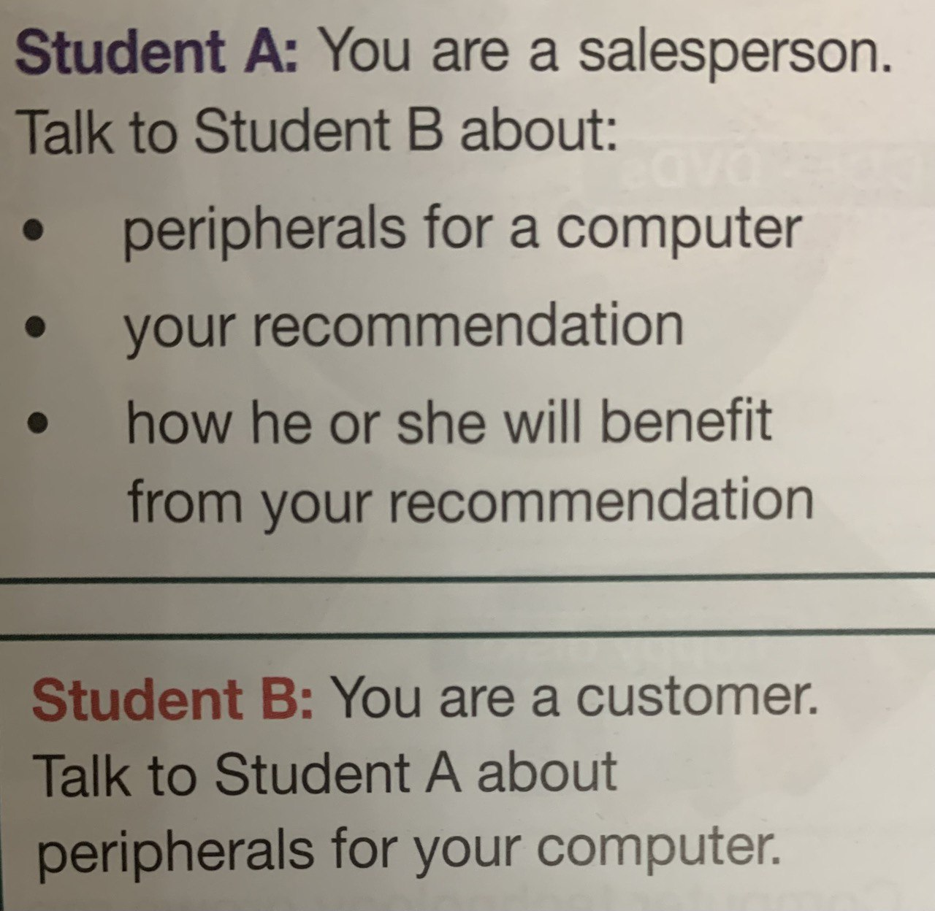

Speaking time!
Act out this situation

Slide 28
Use the conversation from previous task to fill out the customer feedback form.
Computers Direct
Customer Feedback Form
What did you purchase?
Was the salesperson helpful? Y/ N
Why or why not?

Slide 29

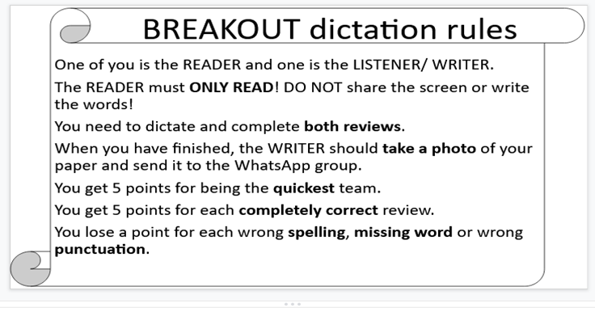

Slide 30
Your home task is to answer the questions in written form. 1. What are in your opinion the most urgent computer problems? 2. Give characteristics of your own computer components and try to describe a model of future computer.

Slide 31


THANKS!
Do you have any questions?

